Slide 1
Status of the Asian Apparel Industry After The Pandemic
FREUDENBERG
Performance materials
ANFA NW Conference 2023
October 30, 2023
Hong Kong

Slide 2
Self Introduction
Since 2020 Senior Vice President and General Manager, Global Apparel Division
Freudenberg Performance Materials (Weinheim, Germany)
2015 Managing Director and General Manager, Asia Apparel
Freudenberg & Vilene International Ltd. (Hong Kong)
2012 Head of Medical Product Sales
Japan Vilene Company Ltd. (Tokyo)
2010 Senior Manager, Corporate Planning Department
Japan Vilene Company Ltd. (Tokyo)
2005 Global Lead and Head of International Sales & Customer Relations (ISCR)
Freudenberg & Vilene International Ltd. (Hong Kong)
2000 Director of Asia Business Development
Frisby Technologies (North Carolina, USA)
1993 International Sales, Chemical Products Division
Bridgestone Corporation (Tokyo)
1992 MA in International Economics and Asian Studies
The Johns Hopkins University School of Advanced International Studies, Washington DC
1990 BA in International Relations
The Johns Hopkins University, Baltimore USA

Slide 3
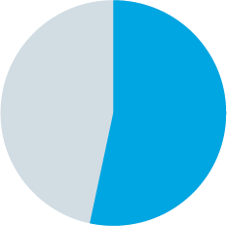
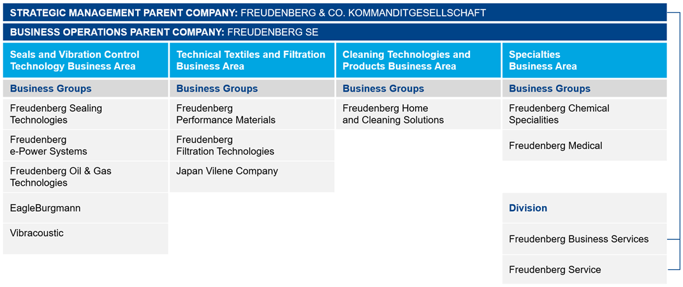
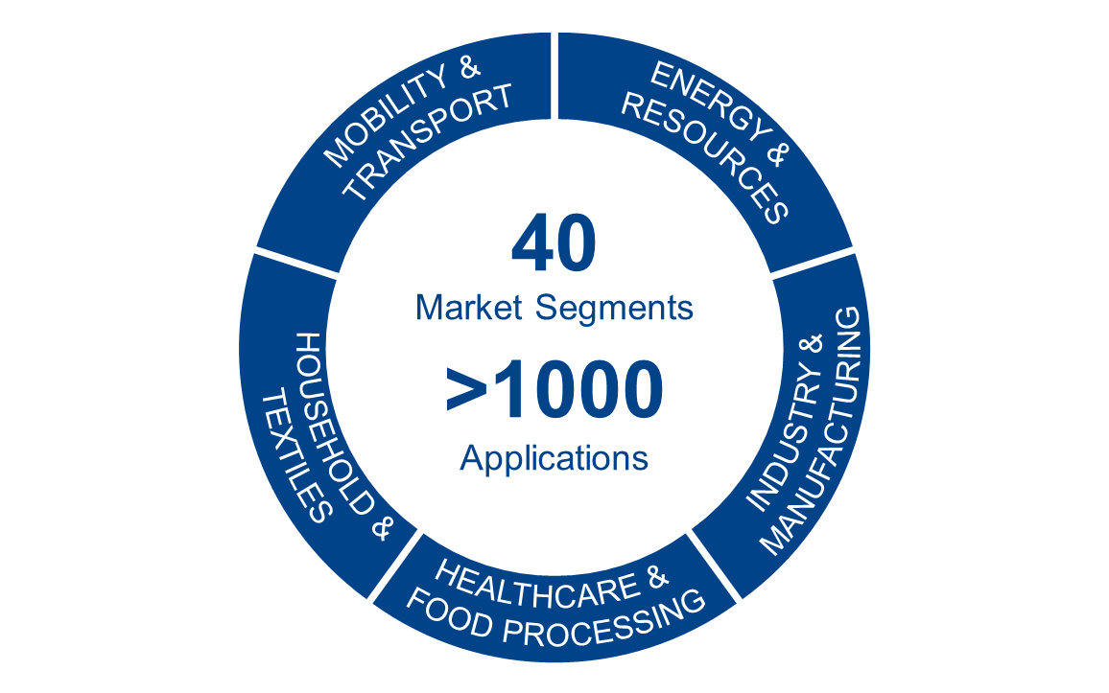
Sales
Operating Profit
Workforce
R&D Spending
Equity Ratio
2022
11,753.1
941.8
51,462
54.0
4,9 %
%
in Million €
in Million €
of sales
Freudenberg
Group
Highly Diversified
Healthcare &
Food processing
Household &
textiles
Mobility &
Transport
Energy &
Resources

Slide 4
Freudenberg apparel asia
Factory
Production & Sales
Sales offices only
Japan
Dalian
Tokyo
Established in 1980 with the founding of Freudenberg & Vilene International Ltd. (FVI) in HK.
FVI is a joint venture between two global interlining leaders – Freudenberg & Co. and Japan Vilene Company.
HK is the Headquarters for Freudenberg’s Global Apparel Division, which is the biggest interlining supplier in the world.
24 sales offices in 13 countries & regions in Asia.
5 production facilities strategically located across Asia.
Warehouses located in key garment manufacturing locations.
Beijing
S. Korea
Seoul
Tianjin
Pyeongtaek
Chinese Mainland
Nantong
Suzhou
Shanghai
Hangzhou
New Delhi
Taiwan
Taipei
Yang Mei
Bangladesh
Guangzhou
Mumbai
India
Dhaka
Hong Kong
Hanoi
Thailand
Vietnam
Philippines
Chennai
Bangkok
Bangalore
Tirpur
Sri Lanka
Ho Chi Minh City
Colombo
Malaysia
Singapore
Indonesia
Jakarta
Bandung

Slide 5
Agenda “Status of the Asian Apparel Industry After The Pandemic”
Changes in the apparel industry due to COVID
Exodus out of China by Western brands??
Rise of the China domestic apparel market
Future of nonwovens in Apparel

Slide 6
Changes in the Apparel Industry due to Covid - A MACRO OVERVIEW
The apparel industry has been called the “caravan on the run”, following the trail of lower production prices wherever it goes. High volumes to drive the cost per unit prices has been the accepted norm. FOB garment cost has been a paramount concern.
Apparel was one of the hardest hit industries during Covid. Supply chain issues including working capital was a particular pain point. The damaging experience during Covid especially related to supply chain struggles together with the geopolitical tensions has put emphasis on “risk mitigation”. Price although still important is not the only driving factor.
The apparel industry especially in Asia after Covid is much more complex with new challenges, uncertainties and risks.
But post Covid has also highlighted potential opportunities in the apparel industry. “Sustainability” as a market mega trend has only increased in momentum especially in Europe and the US apparel market giving rise to new innovation opportunities.
Sustainability as a trend in the Asia apparel market is less visible, but it is only a question of time.

Slide 7
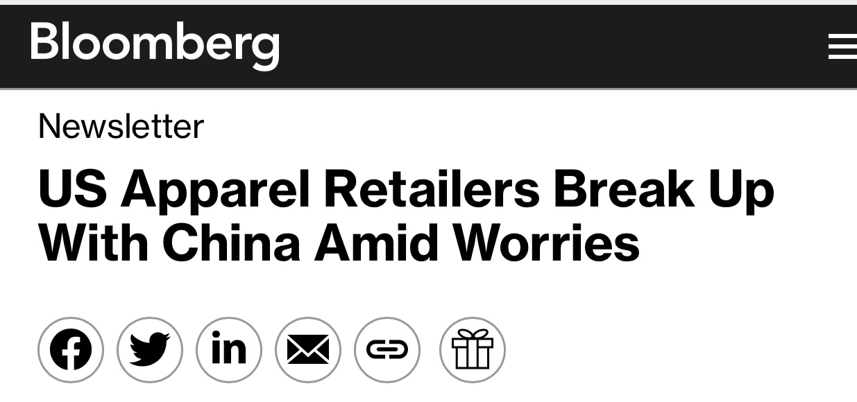
“Exodus” out of China by Western Brands??
61% of US apparel retail CEOs have stopped using China as their primary supplier. This is up from 30% before Covid.
Almost 80% plan to reduce further their sourcing from China. Vietnam, B’desh and India are the prime beneficiaries of this shift.
Geopolitical tensions, supply chain risk mitigation, UFLPA, tariffs etc.- are pushing Western apparel brands to look outside China to produce their garments.
But quitting China is easier said than done… China has some “hard to overcome” inherent advantages such as skilled workforce and supply chain networks.
China is still the biggest apparel exporter for Western brands by far, although the gap with the other garment export countries are smaller compared to the past.

Slide 8
Rise of the China Domestic Apparel Market
Since its entry into WTO, China has been seen as the “factory” to the world. This image has been especially strong in the apparel industry.
But China is not just a garment production country. China is the 2nd biggest apparel consumption market just behind the US.
For the luxury segment and certain global brands like Nike and Uniqlo, the importance of the China apparel market is critical.
In this background, what is often overlooked is the rise of the domestic China apparel brands. They are challenging the Western brands for dominance in the China market and they are not doing it with price alone. Their goal is to deliver better value to the China consumers by raising their quality level, innovation, design and merchandizing. And they are targeting expansion outside China into Southeast Asia.

Slide 9
Future of NonWovens in the Apparel Industry
Nonwovens was in the past the “go to” interlining for the apparel industry. This changed about 20 years ago when wovens and knit, with prices decreasing, emerged as a substitute for nonwovens.
Nonwovens interlinings is now seen as a “commodity” product. Price is the key decision criteria. Quality differentiation and innovation potential is considered minimal.
Exception would be wadding insulation as it is considered a critical component for the garment. Quality differentiation and innovation potential exists. But wadding insulation is a small segment compared to the much bigger interlining one.
Nonwovens outlook for the apparel market in general has been unattractive.
But in Sept 2022 with the launch of Nike Forward, there is renewed interest in nonwovens, not as an interlining, but as a potential outer fabric application. Innovation and sustainability are the keys to success.

Slide 10
Thank you!

